Slide 1
Software Design & Development CFS2160
Week 11 – Creating a Java Class in IntelliJ

Slide 2
Session Plan
Firstly we are going to look at class structure in Java and how to create a class in IntelliJ
Work on todays worksheet.
Then work on any outstanding practical work.

Slide 3
Anatomy of a Java Class
Java classes require most but not all of the following items to be used in a program. Generating the following when creating a new class is a very good habit to get into.
Class Name (must be the same as the file name without exception!)
Attributes (which require a datatype, int, String etc. Should always be private)
Constructor (method to create and initialise the state of an object of a class)
Methods (perform other logic in the program)
Getters and Setters (public methods used to get and set the values of attributes)
Main Method (used as the starting point of the program, not always required)
IntelliJ contains the functionality for us to create EVERYTHING we need for a class.

Slide 4
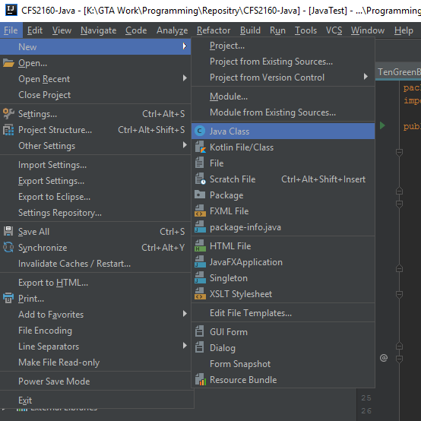
Create a Class
In IntelliJ select, ‘File > New > Java Class’
Make sure your class / file name is sensible and relates to the real world object it represents.
Class names should start with a capital, each subsequent word should be capitalised.
i.e.
UniversityCourse
Tip, it is a good idea to think about folder names and structure when creating a new file.

Slide 5
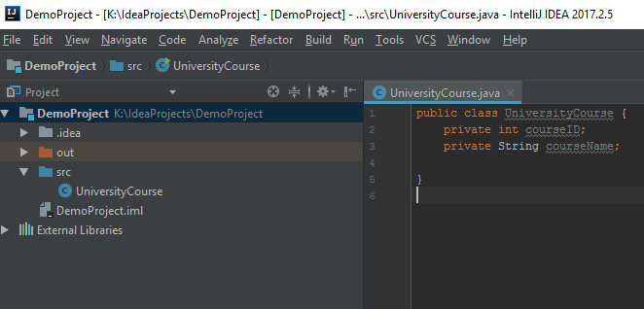
Add Attributes
Add any attributes below the class name, use sensible names, the first letter should be lowercase and each subsequent word capitalised, you can add more attributes later if required.
In Java, we have to declare the data type of the attribute.
We also have to set its access modifier, should be private.
We also need to the ; symbol at the end of each definition.

Slide 6
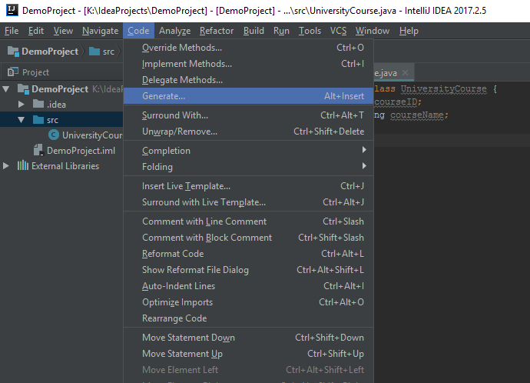
Add Getters and Setters
To generate the Get and Set methods in IntelliJ click ‘Code > Generate’
Getters and Setters are used to retrieve the values stored in the attributes of an instance of a class.
Getters and setters will usually be public access and allow interaction with attributes that should always be private access.

Slide 7
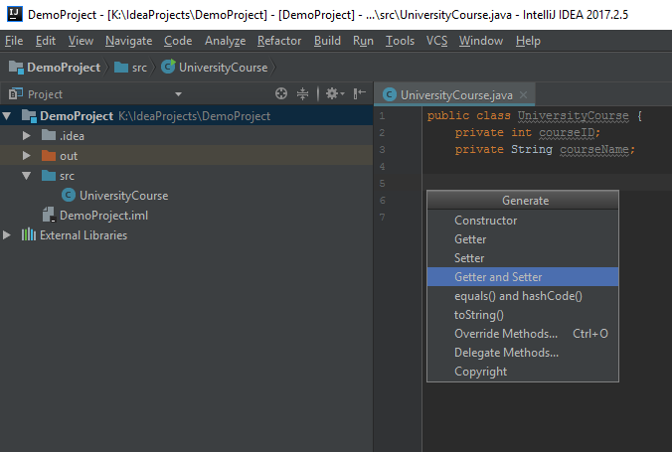
Add Getters and Setters
Then select the Getter and Setter option.
Tip, your cursor needs to be inside the brackets of the class to generate these items.

Slide 8
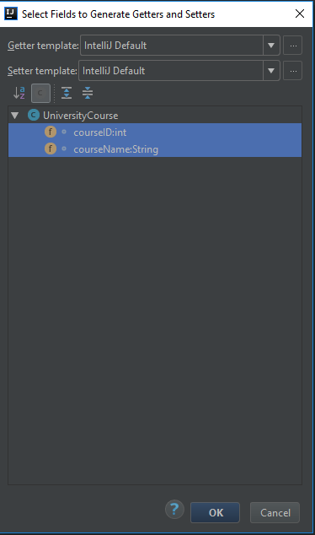
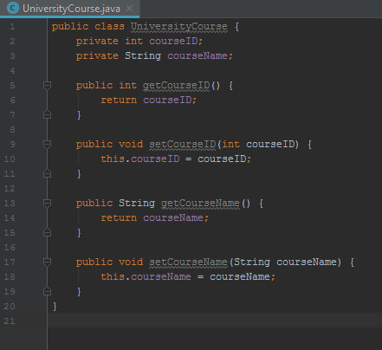
Add Getters and Setters
Highlight the attributes you wish to generate Getters and Setters for and click ‘OK’
Your class should now look something like this, note the Set methods assign a value to the attribute. The Get methods return the value of the attribute.

Slide 9
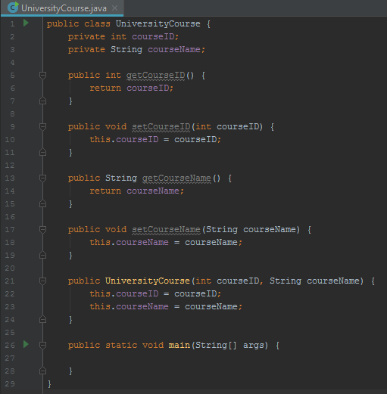
Add the Rest
You can use the same process to add more class components, add the Constructor.
Type psvm into the class and IntelliJ’s auto complete will suggest a method called Main(), add that too and you should have something like this.
Get into the habit of doing these actions EVERY time you create a Java class, once it becomes second nature it will save you a lot of time.

Slide 10
A Basic Class
We now have a basic (but lacking functionality) Java class.
We need to add some more code to get it to do something.

Slide 11
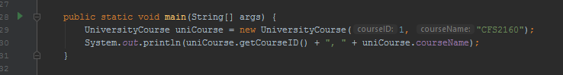
A Basic Class
Write the following code into the Main method, pay attention to the suggestions made by IntelliJ, they can save you time. (IntelliJ can sometime offer the wrong suggestion so be careful!).
//create an instance of the class, pass the required values into the constructor
UniversityCourse uniCourse = new UniversityCourse(1, "CFS2160");
//use the get methods of the class to retrieve values and print them to the terminal
System.out.println(uniCourse.getCourseID() + ", " + uniCourse.getCourseName());
So it looks like this
Finally click the green arrow and run the program.
The arrow only appears in class with a Main() method.

Slide 12
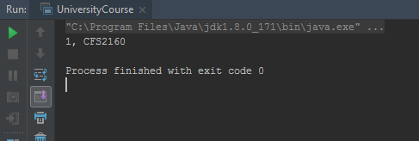
The Output
Just like in PyCharm, the output will be in the terminal window. Our program has outputted the values we added when we created a new object of the class UniversityCourse.
Congratulations, you have just created an object of a Java class.
Change the values in the Main method where the constructor is called and see what happens.

Slide 13
Finally
From now on, your programming tutorials will be for java ONLY, if you have outstanding Python work you should continue working on this in your own time. You can book 1 to 1 sessions with me for help or email any member of the module team for help and feedback.
I will able to help with both Python* and Java in my sessions.
Any questions about Java?
Look at todays worksheet
* I hope you have all completed your Python Programming Task.

